Slide 1







DATA ANALYtics Current and Future Trends
Junior Agyapong
March 24, 2025

Slide 2



OUTLINE
Executive Summary
Introduction
Methodology
Results
Visualization – Charts
Dashboard
Discussion
Findings & Implications
Conclusion
Appendix

Slide 3

EXECUTIVE SUMMARY
This report presents key insights derived from surveys of technologies used and desired/preferred next year. The results are generate using IBM Cognos Analytics, with most trends being determined visually
Some Key findings include
Javascript and HTML/CSS are still one of the leading used languages, currently and for next year
Most of the top 10 databases currently use remain top 10 desired for next year, although there are shifts amongst ranking
Based on the respondents, the industry appears to be dominated by men, within 20-40 years old, with the majority only having a bachelor degree

Slide 4

INTRODUCTION
This presentation summarizes surveys for analyzing current and future tech trends, focusing on languages, databases, platforms, and demographics.
The purpose is to provide insights into today's most used technologies and emerging trends, guiding business and workforce strategies.
Key Stakeholders of this report are
Hiring professionals seeking to ensure candidates have the most desired skills
Individuals wanted to ensure that their skills and knowledge is up to date
Technology providers who need to know where their products stand in comparison to competitors

Slide 5

METHODOLOGY
The data is a collection of surveys distributed to technology-using respondents
Questions ranged from most currently used programs and computing languages to age, gender and other demographics
The results are compiled into an Microsoft Excel .CSV file
The files were uploaded to IBM Cognos Analytics to generate visuals and to assist in discovering trends, within the compiled responses

Slide 6
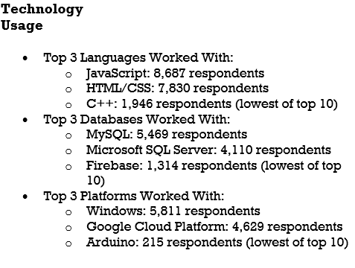
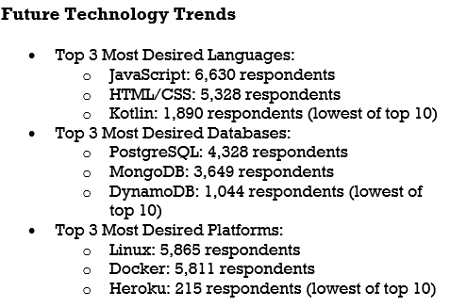
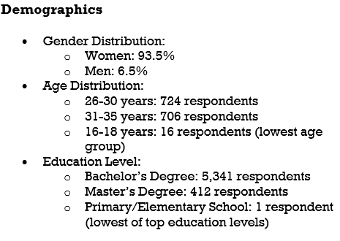
RESULTS

Slide 7
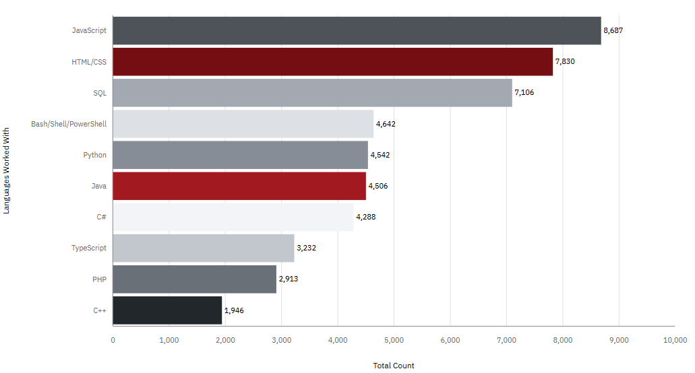
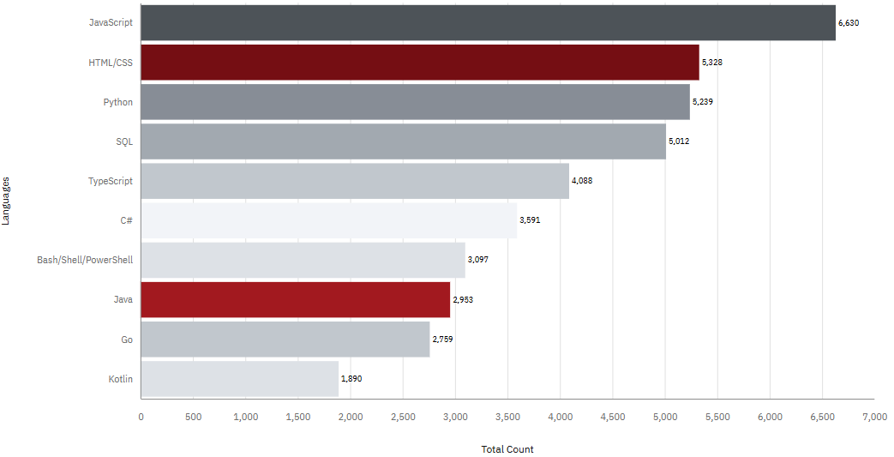
PROGRAMMING LANGUAGE TRENDS
Current Year (Most Used)
Next Year (Most Desired)
< Bar chart of top 10 programming languages for the next year goes here.>

Slide 8
Language TRENDS - FINDINGS & IMPLICATIONS
Javascript and HTML/CCS are the most utilized computing language, currently, and are the most desired languages next year
Javascript is still the most desire computing language of all
The majority of technology are still Javascript and HTML/CSS based for the foreseeable future
Python is the 5th most utilized language but is anticipated to be the 3rd more desire language next year.
This jump may signify that python is gaining tractions in being more utilized in the future
Those who are using current top languages such as SQL and Bash/Shell may need to pick up python in the future
C++ and PHP are top 10 currently, but won’t be next year
Less technology will call for C++ and PHP coding in the future
Similar to SQL and Bash/Shell, those still utilizing C++ and PHP should pick up a new language to stay up to date in the future

Slide 9
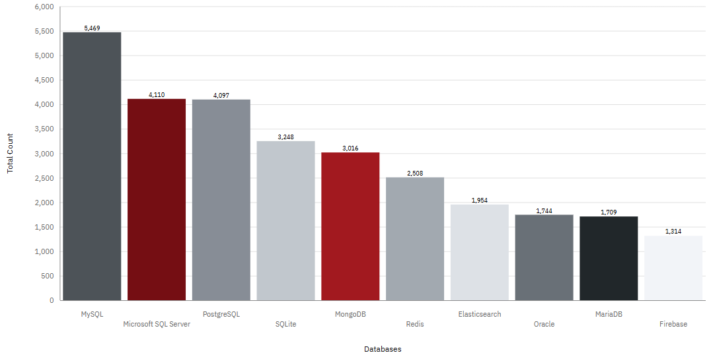
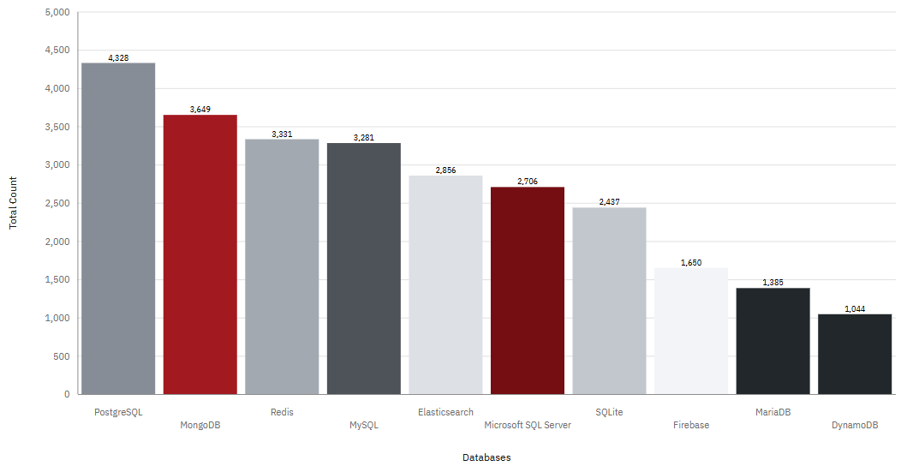
DATABASE TRENDS TOP 10
Current Year
Next Year
< Bar chart of top 10 databases for the current year goes here >
< Bar chart of top 10 databases for the next year goes here.>

Slide 10
DATABASE TRENDS - FINDINGS & IMPLICATIONS
MYSQL is the most utilized database, but is the 4th most desired database, next year
This suggest there may be advancements in the database industry where MySql is less preferred.
This may not mean that MySQL isn’t useful, just that preferred database trends are shifting
PostgreSQL and MongoSQL, who are 3rd and 5th most utilized database are the 1st and 2nd most desired database, next year
Similar to the above, this would changes in the database trend, suggesting that Postgre and Mongo will be most suitable for future trends
It also suggest that PostgreSQL and MongoSQL have made modifications to their program that make it most preferred (UX design, ease of use, powerful querying apps, etc)
Oracle, which was the 7th most utilized database does not make top 10 desired databases next year
Similar to the above, this suggest that current trends are shifting away from using Oracle

Slide 11

DASHBOARD
Github Link
https://github.com/Junior416/DataAnalystCapstoneP1/blob/6b3e5db715ecd09cfd5bb66a6baf9738db649f96/Part%201A%20-%20Building%20A%20Dashboard%20With%20IBM%20Cognos%20Analytics.pdf

Slide 12
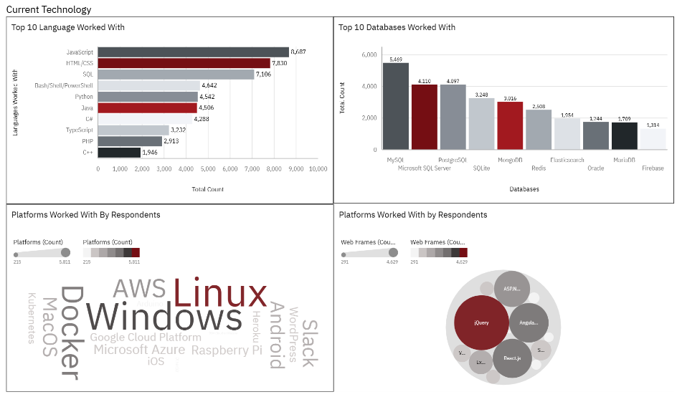
DASHBOARD TAB 1

Slide 13
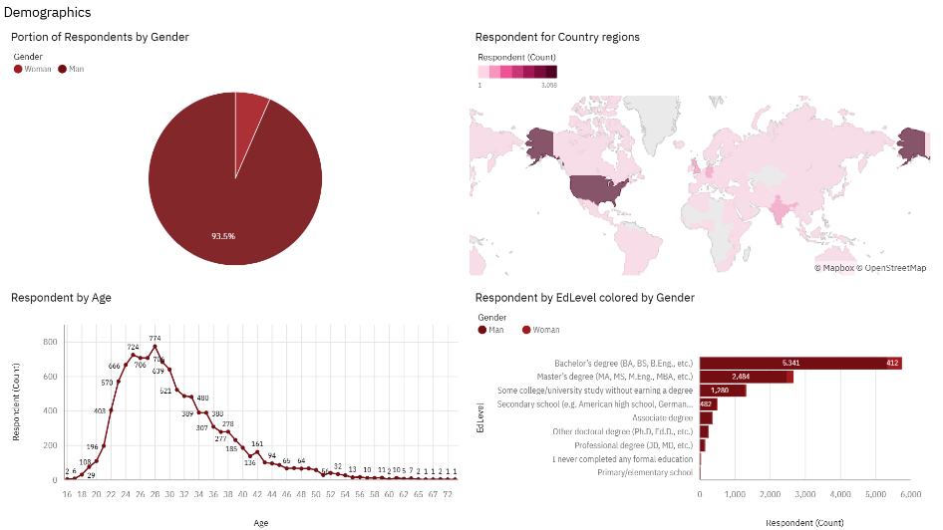
DASHBOARD TAB 3
Screenshot of dashboard tab 3 goes here

Slide 14
DISCUSSION
There are certain technology trends that do not change much while others see significant shifts. As such, changes in data analysis technology needs a watchful eye, in order for users to stay up-to-date
With Javascript and HTML/CSS being the top languages, thus can be assumed as the foundations of computing language.
However, in areas such as Databases, they is significant shifts between currently used and desired for next year. Therefore the concept of “staying ahead of technology” isn’t universal amongst all segments
As global initiative increase for equality in the work place, only 6% of the respondents are women

Slide 15
OVERALL FINDINGS & IMPLICATIONS
Technology shifts in trends are not universal
From a hiring standpoint to a individual use standpoint, it would be in anyone’s best interest to stay on top of changing trends. Someone may be content with their HTML knowledge but not realize their MYSQL knowledge is becoming less desirable
Current users are significantly men who are relatively young, ie just completing post secondary
This would suggest that Data analysis is a young person’s game. Older individuals wanting to get into Data Analysis now may face strong competition
However, in a push for more diversification, women interested in this industry may find success, even in an older age. The hiring trends amongst women should be review

Slide 16

CONCLUSION
Prevalence of Core Technologies:
JavaScript, HTML/CSS, MySQL, dominate current technology usage, indicating a continued reliance on these foundational tools.
Emerging Trends:
PostgreSQL, MongoDB are gaining traction, suggesting a shift toward different solutions and needs in the near future.
Actionable Insights:
Organizations should align their development and infrastructure strategies with the top languages, databases, and platforms to stay competitive and meet industry demand.
Hiring Trends
The industry is highly occupied by young men. Organizations should attempt to diversify the employment trends which could lead to a rich inclusion of various experiences and insights

Slide 17

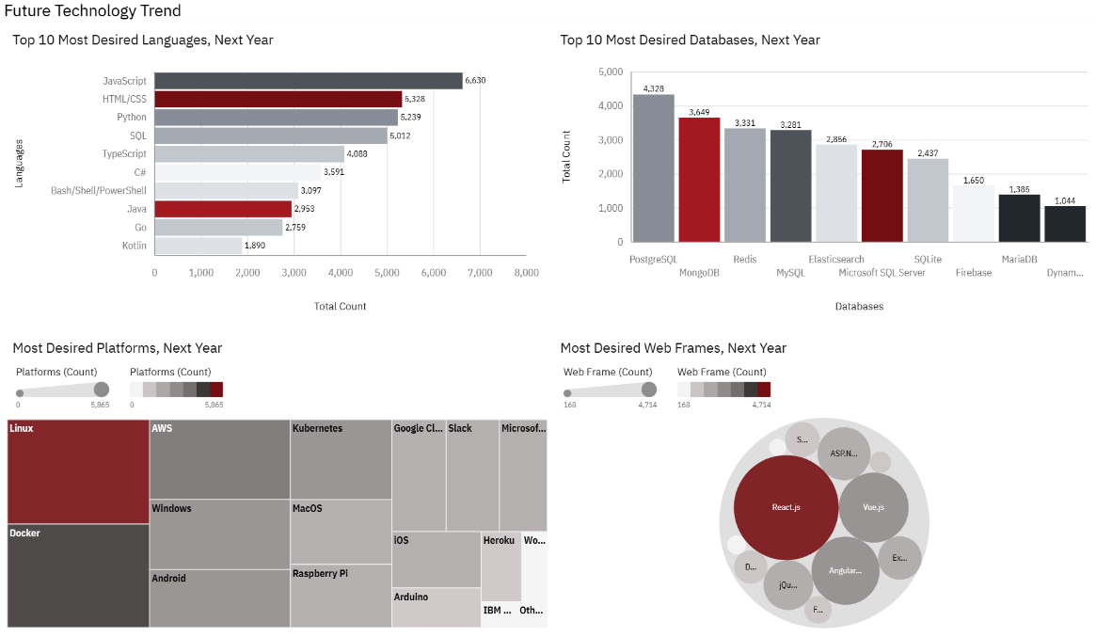
APPENDIX

Slide 18
APPENDIX
Link to Survey Data: Technology Trends - https://cf-courses-data.s3.us.cloud-object-storage.appdomain.cloud/IBM-DA0321EN-SkillsNetwork/LargeData/m5_survey_data_technologies_normalised.csv
Link to Survey Data: Demographic Trends - https://cf-courses-data.s3.us.cloud-object-storage.appdomain.cloud/IBM-DA0321EN-SkillsNetwork/LargeData/m5_survey_data_demographics.csv

Slide 19
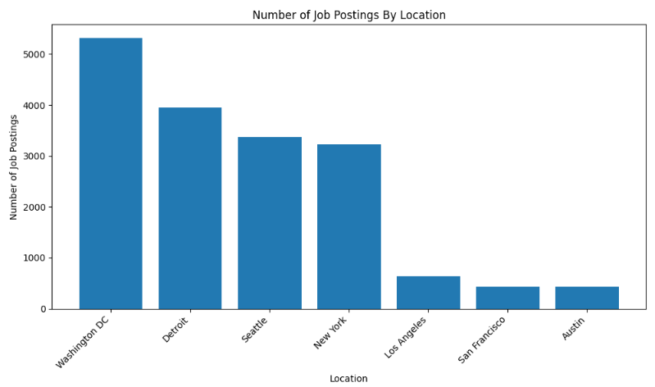
JOB POSTINGS
In Module 1 you have collected the job posting data using Job API in a file named “job-postings.xlsx”. Present that data using a bar chart here. Order the bar chart in the descending order of the number of job postings.
Here are the number of Jobs per City as specified in the lab

Slide 20
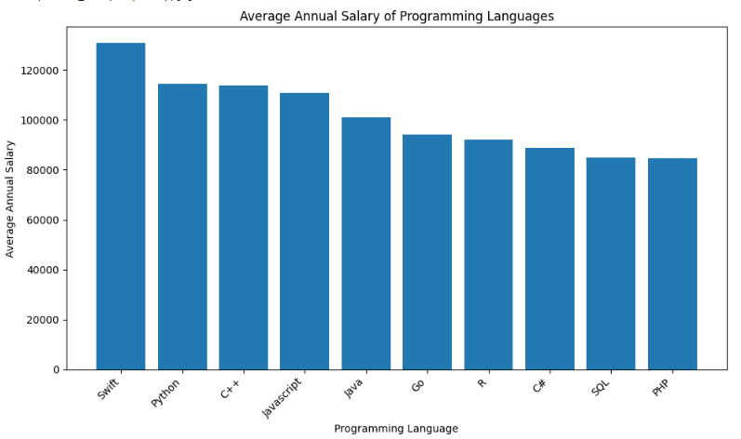
POPULAR LANGUAGES
In Module 1 you have collected the job postings data using web scraping in a file named “popular-languages.csv”. Present that data using a bar chart here. Order the bar chart in the descending order of salary.
Here are the average salary per programming language

